Slide 1

Neuroergonomics of an At-Home VR-based Psychophysical Procedure Compared to Clinical Visual Field Perimetry
Session 1: Clinical Neuroergonomics & Brain Health
Ronald Zambrano, MSc, PhD(c)
Wills Eye Hospital, Glaucoma Service, Philadelphia, PA, USA
Drexel University, School of Biomedical Engineering and Science, Philadelphia, PA, USA
6th International Neuroergonomics Conference — Boston, MA

Slide 2
Financial Disclosure
I have no financial interests to disclose

Slide 3
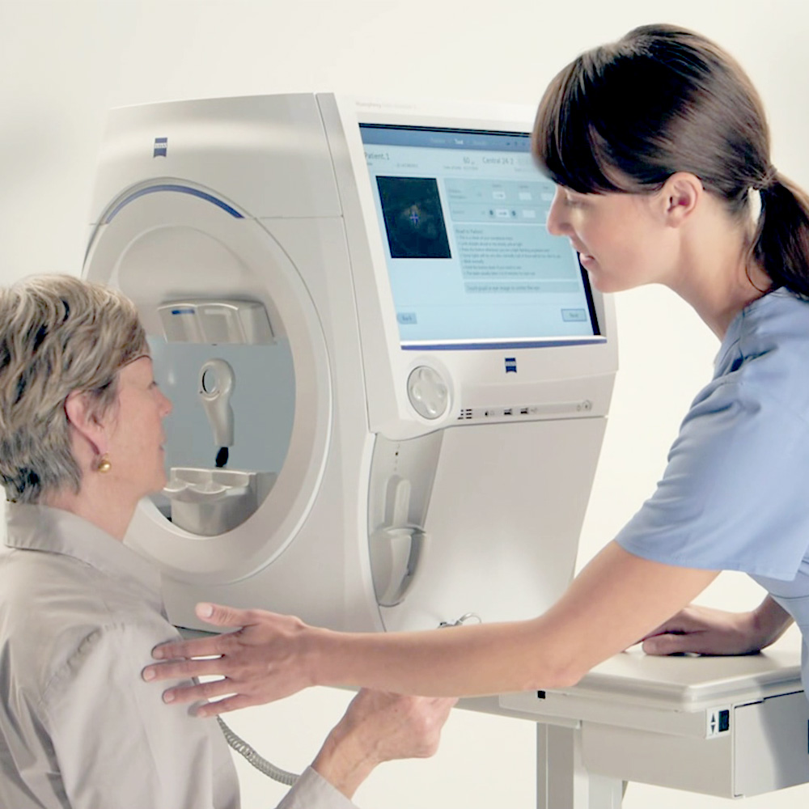
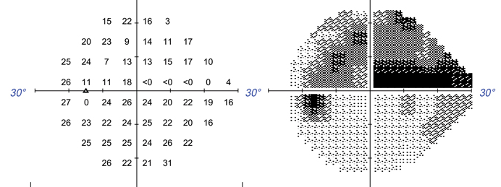
The Visual Field Test
Perimetry, quantitatively maps functional vision
  Standard of care across ophthalmology
  Guides diagnosis, monitoring, treatment
  Critical for irreversible diseases like glaucoma
Informs where and how much a patient sees
Detects vision loss, even when patients can’t
Visual function reference standard for decades¹
zeiss.com
1. Li, A., & De Moraes, C. G. (2025). Ophthalmology. Glaucoma, 8(5S), S20–S26.

Slide 4
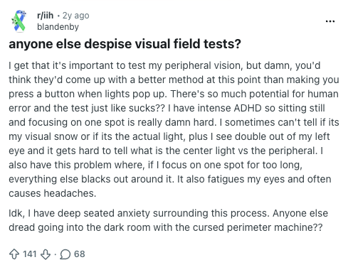
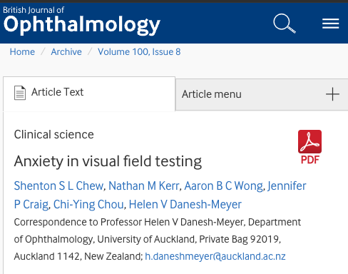
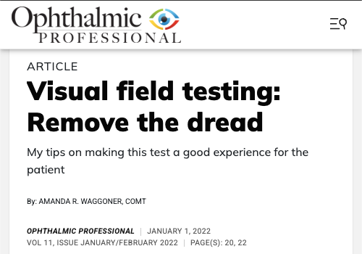
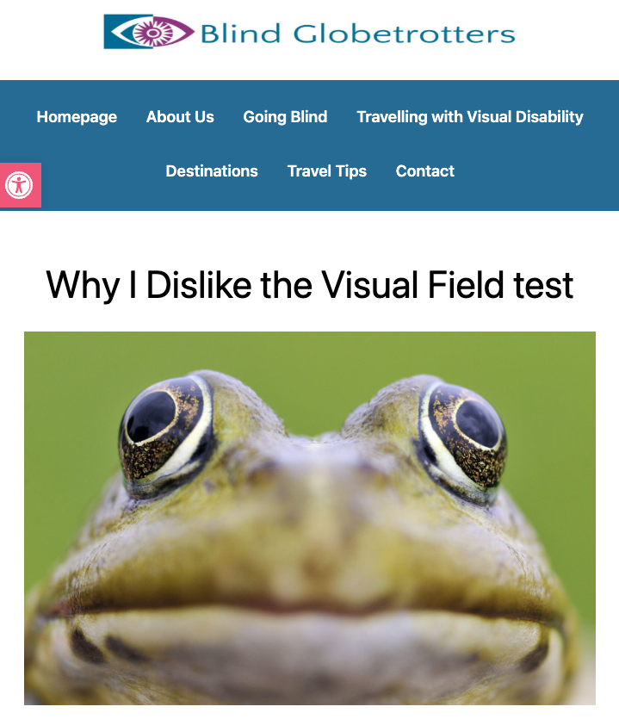
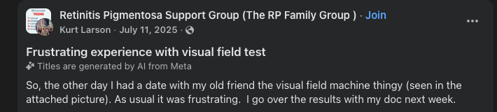
There is one problem…

Slide 5
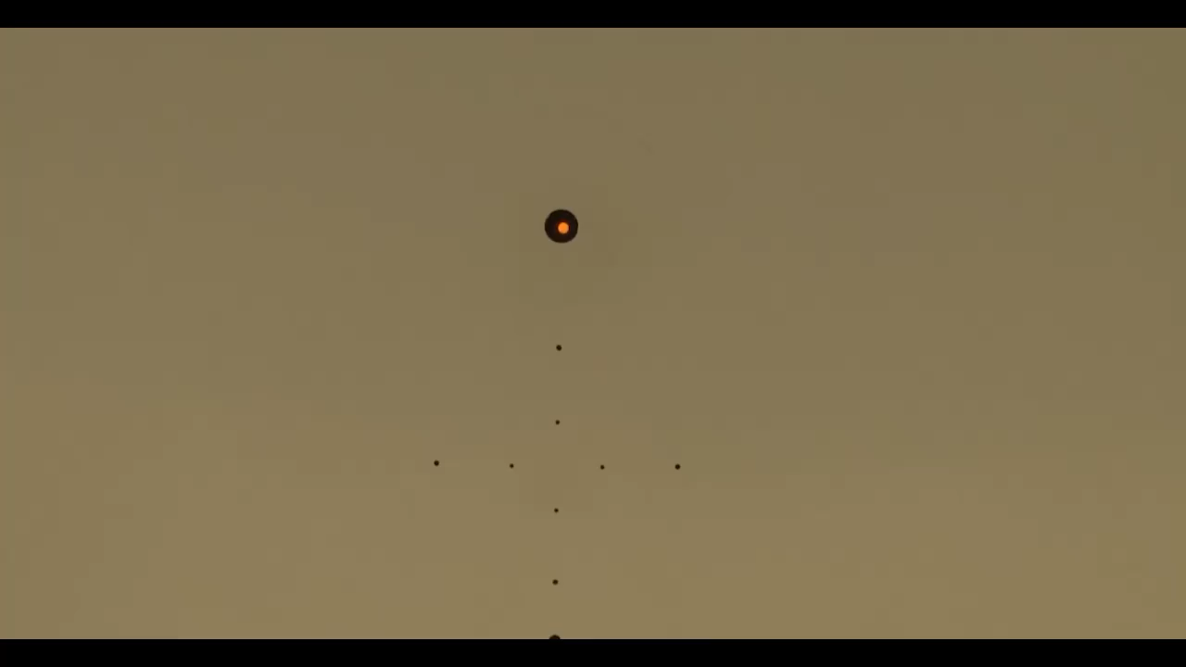
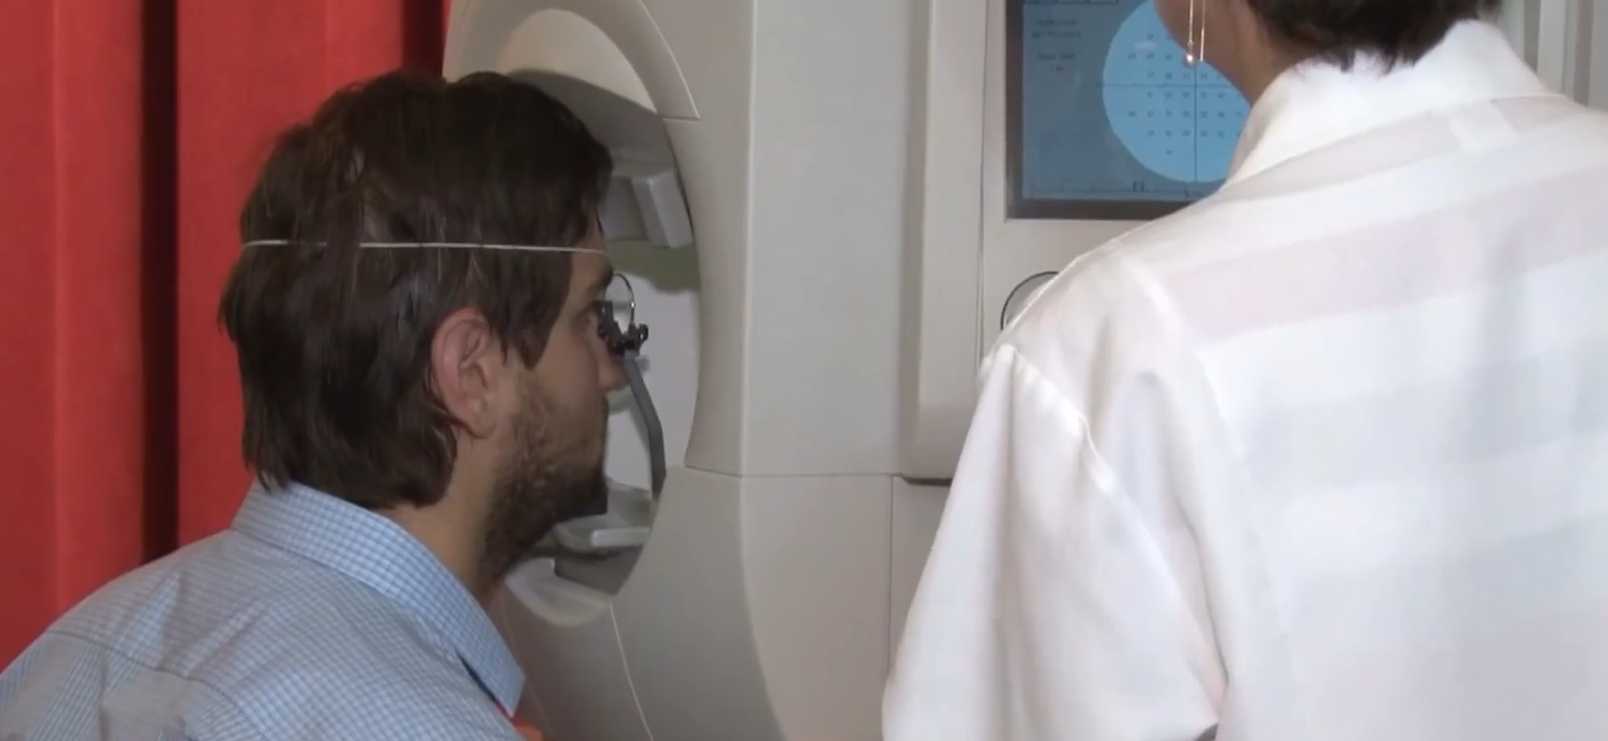
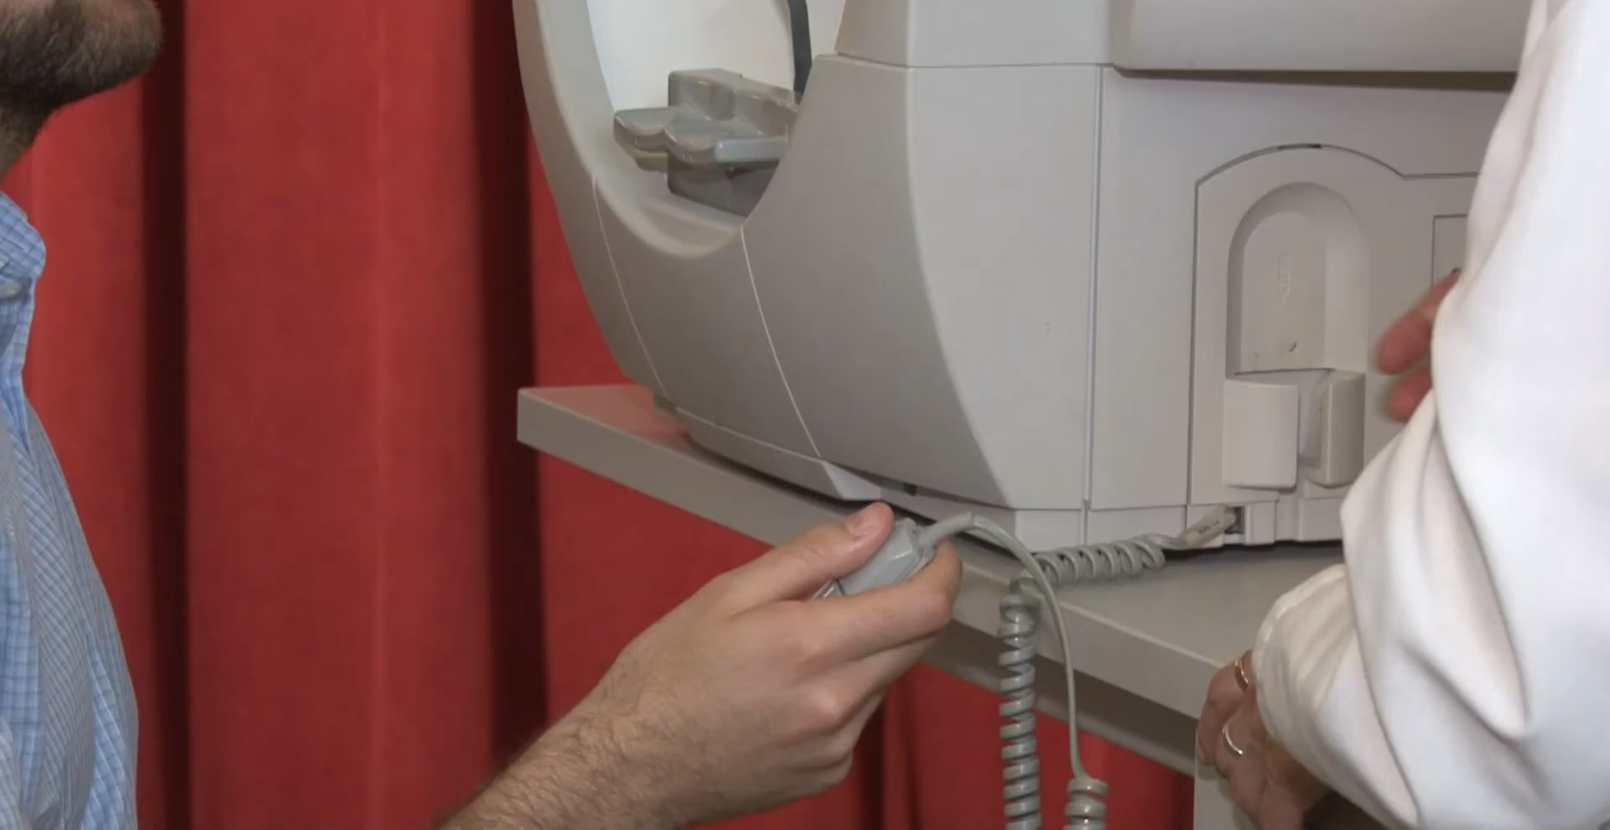
The Problem with Standard Perimetry
Cognitively demanding
  Constant vigilance + Immediate user input
  Ergonomic burden: chin rest, one eye covered, dimly lit, clinic-bound
  Fatigue (Duration:10-25 min)
High variability
  Up to 40% unreliable tests in some studies²
Human-factors problem: test design, not the patient, causes most of the issues
willseyehospital.org
2. Birt, C. M. et al., (1997). Ophthalmology, 104(7), 1126–1130.
Notes:
Sustained fixation + constant vigilance
Unnatural task: suppress the urge to look at what you see
Cognitively demanding
Sustained fixation + constant vigilance
Repeated immediate user feedback
Fatigue (Duration:10-25 min)
Ergonomic burden: chin rest, one eye covered, clinic-bound
Highly variable
Up to 40% unreliable tests in some studies²

Slide 6
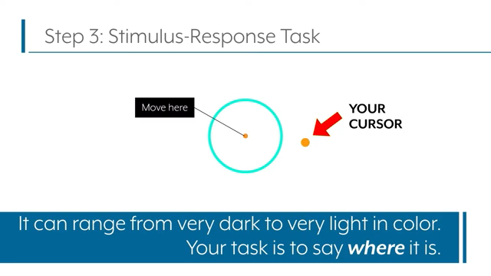
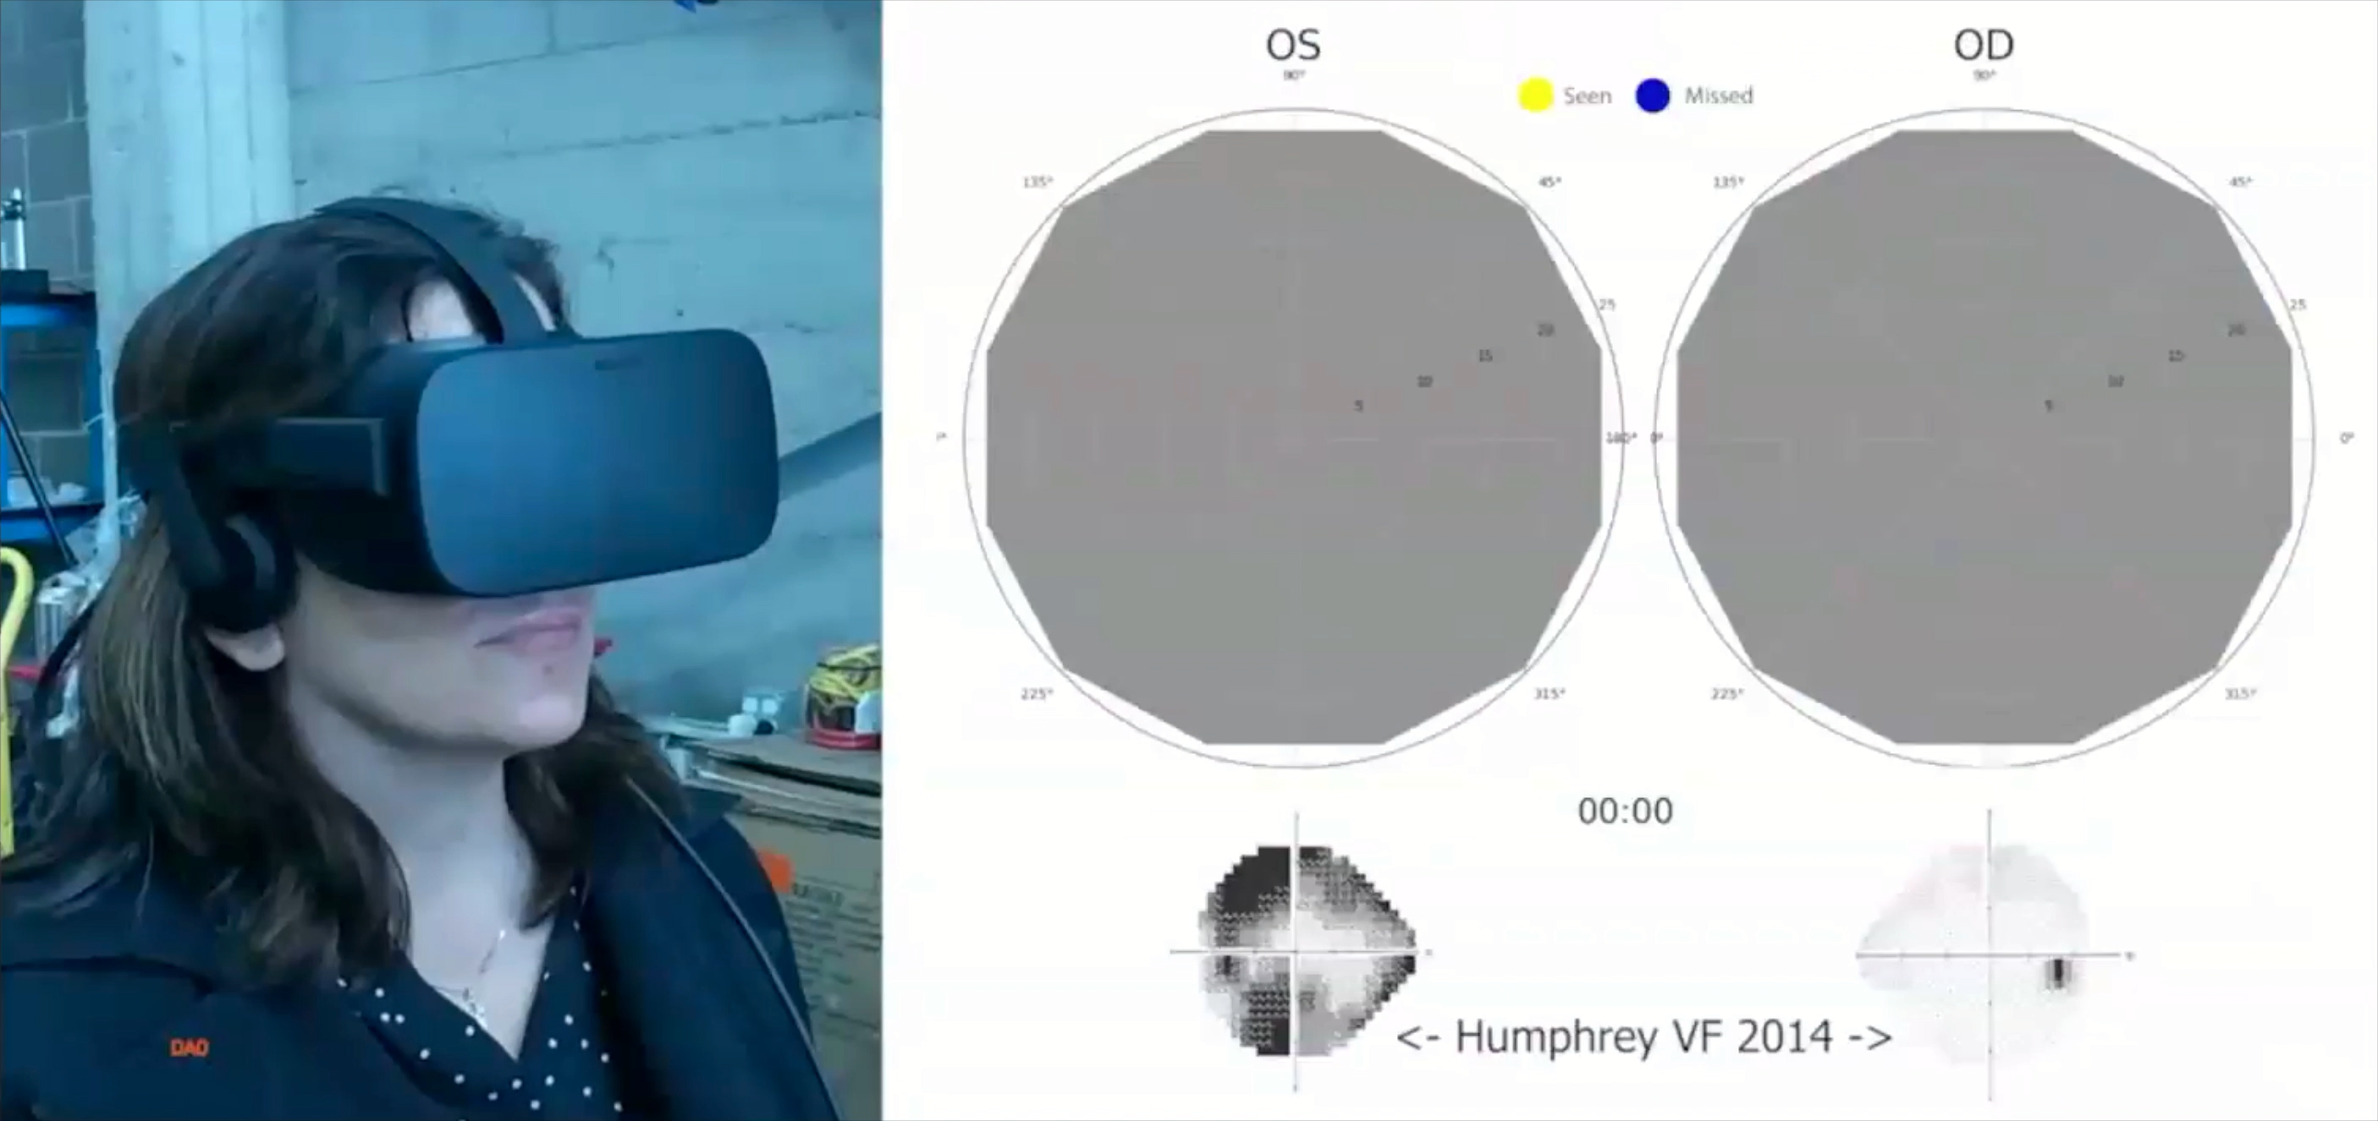
Vivid Vision Perimetry (VVP)
A human-factors redesign
VR headset, performed anywhere
  Self-paced · rest allowed · both eyes
Uses natural fixation approach
  Localize, don't just detect
Adaptive: learns a priori VF defects to reduce future test duration
Perimetry redesigned to
  Meet current standard reference
  Decrease neurocognitive burden
seevividly.com
Notes:
Sustained fixation + constant vigilance
Unnatural task: suppress the urge to look at what you see
Cognitively demanding
Sustained fixation + constant vigilance
Repeated immediate user feedback
Fatigue (Duration:10-25 min)
Ergonomic burden: chin rest, one eye covered, clinic-bound
Highly variable
Up to 40% unreliable tests in some studies²

Slide 7
Study Aim
Overall Aim: Evaluate Vivid Vision Perimetry (VVP) as an alternative to Standard Automated Perimetry (SAP) in a glaucoma cohort
Specific Aim 1: To determine whether VVP produces measurements that agree with SAP
Specific Aim 2: To assess whether VVP reduces neuroergonomic burden across symptom, usability, preference, and confidence

Slide 8
Methods

Slide 9
Study Design & Analysis
1
Enrollment
2a
VVP
2b
SAP
3
Surveys
Prospective Study
Wills Eye + UCSF
Glaucoma/ Healthy
In-clinic training
Bundle of 10 sessions
~14 days
~18 min each
4× Humphrey
24-2 SITA (Zeiss)
Across 2 clinic visits within 14 days
After training & after bundle
Symptoms
Usability
Preference
Confidence
Agreement
Comparison
Analysis
Pearson correlation
Wilcoxon signed-rank test

Slide 10
Results

Slide 11
Study Cohort
Characteristic | Value
Enrolled participants (Glaucoma/ Health) | 63 (52/11)
Age, mean (SD), y | 59.4 (14.8)
Women / Men, n | 41 (65%) / 22 (35%)
Site: Wills / UCSF | 37 / 26
Completed home bundle (≥10 sessions ≤14 d) | 54 (85.7%)
Provided post-bundle survey data | 55 (87.3%)
Did not complete bundle / lost to follow-up | 9 (14.3%)
Retention defined as completion of the 10-session home bundle within 14 days.

Slide 12
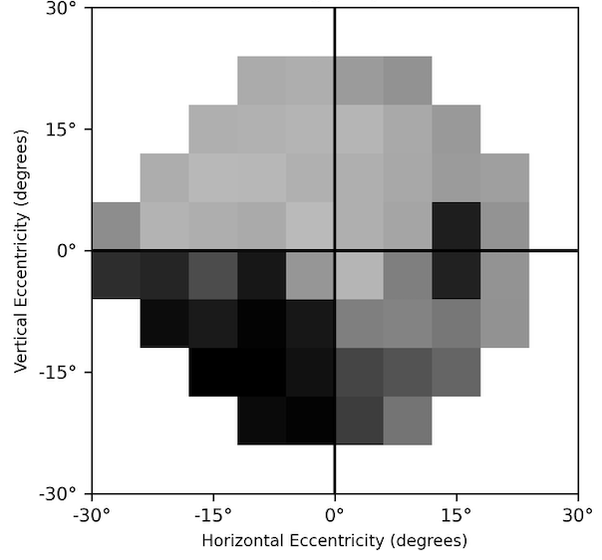
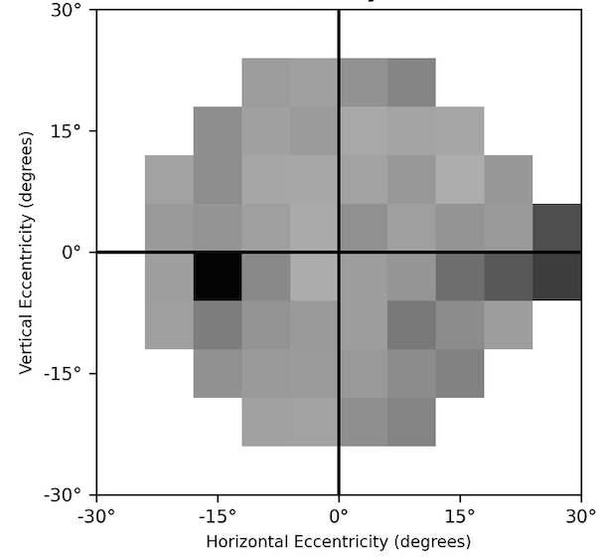
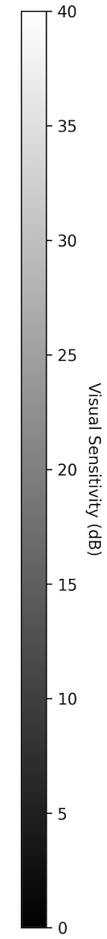
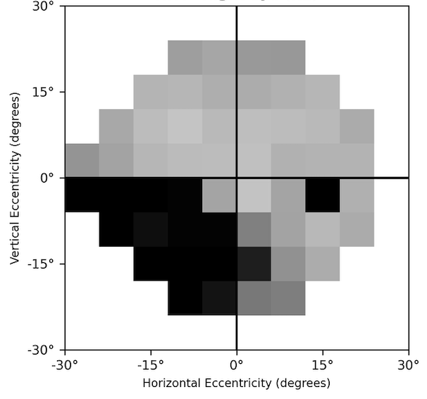
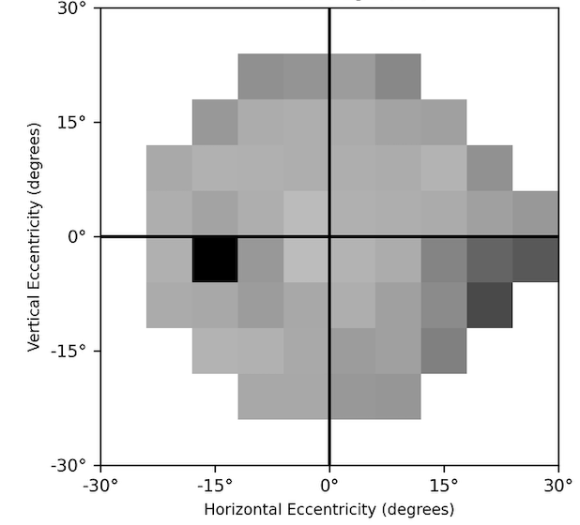
VVP and SAP reveal similar VF loss
Right Eye
Left Eye
VVP
SAP​

Slide 13
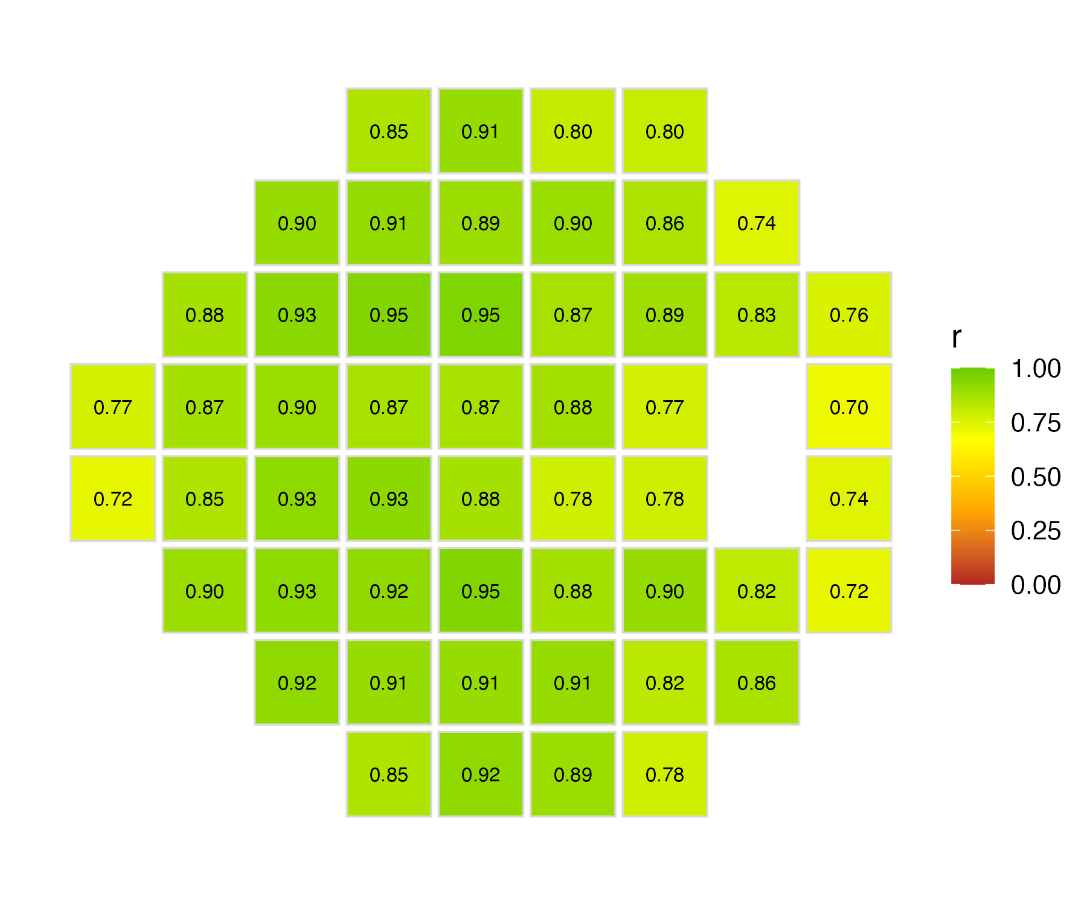
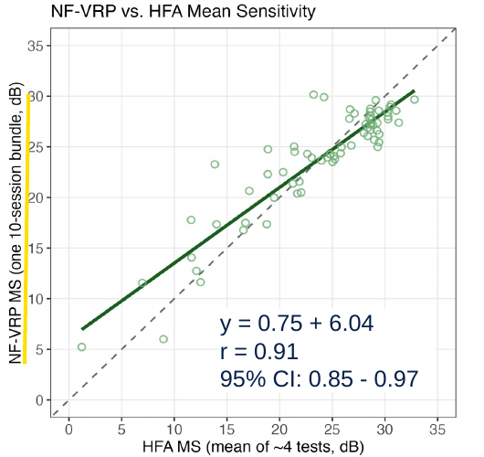
VVP agrees with SAP
Strong Correlation of Average mean sensitivity: 10 VVP vs 4 SAP
Similar strong correlation is seen pointwise (r = 0.70 – 0.95)
3. Shiu et al., (2026), IOVS Vol.67, 5572

Slide 14
Patients reported lower symptom burden
Post-test symptom severity (0–4; lower is better) after at-home VVP vs in-clinic SAP
Every domain significantly favored VVP
Symptom | VVP | SAP | p
Eye burning | 0.45 | 0.79 | 0.008
Eye dryness | 0.84 | 1.29 | 0.003
Eye strain | 0.93 | 1.44 | 0.003
Eye tearing | 0.42 | 0.78 | 0.004
Eye tiredness | 1.22 | 1.71 | 0.004
Neck/back soreness | 0.84 | 1.35 | 0.034
Non-parametric Wilcoxon signed-rank test/ Benjamini-Hochberg-corrected
Values are mean (SD) symptom-severity scores on the study’s ordinal scale; lower scores indicate less symptom burden.

Slide 15
Patients preferred VVP
After the home bundle, most patients preferred VVP to SAP;
  preference grew from training day
  to post-bundle
  Top drivers: time savings, ability to rest, both eyes at once, convenience
Patient Confidence rose for VVP (3.6→4.1, p<0.01)
* preference scored on a Likert scale (0-4)

Slide 16
Discussion

Slide 17
Discussion
At-home VVP agrees closely with the SAP, overall and point-by-point
Patients report less symptom burden, prefer VVP after real use, and trust its results more than standard clinical SAP
Limitations:
  Unequal test count and strategy: 10 VVP vs 4 SAP; Not true 1:1 comparison
  Surveys: study-specific; Likert/ordinal; small (significant) magnitude differences
  Modest sample: Only testing early experience. Will findings hold over time?

Slide 18
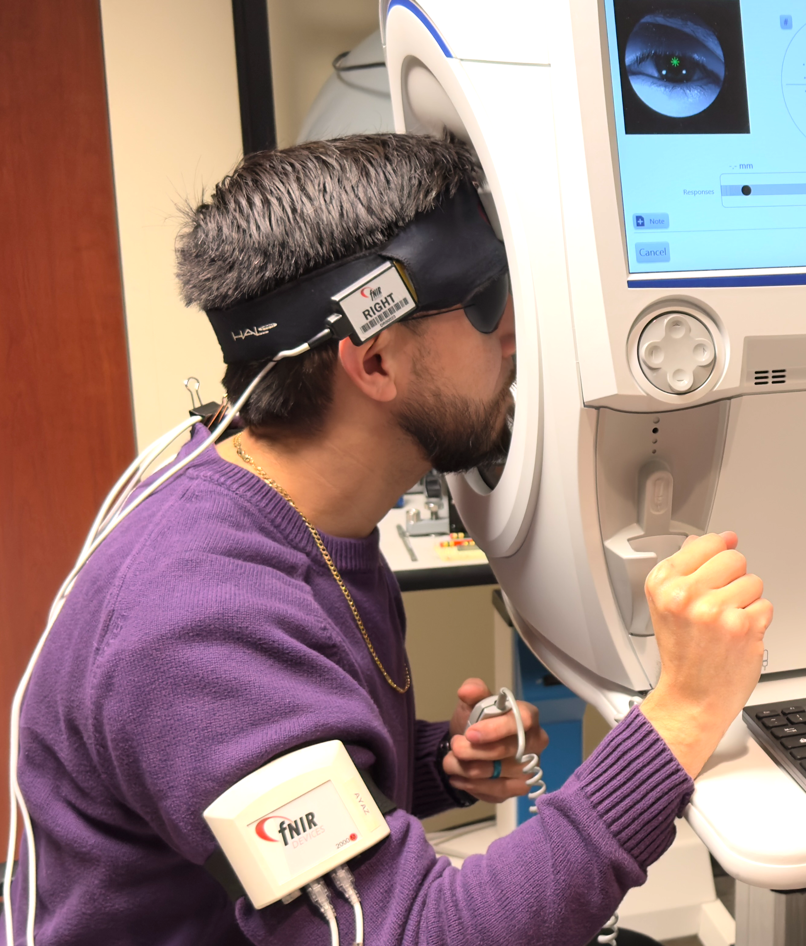
Future Directions
Quantify neurocognitive effects on perimetry
Currently enrolling for a multimodal
Perimetric-Neuroimaging study
  fNIRS monitoring neural correlates during Perimetry (SAP & VVP)
For more information, please visit our poster
  Session: Applications, Safety & Ethics in Real-world Domains [H4-Wednesday]

Slide 19
Conclusion
Designing the perimetric task around human attention and natural eye movement reduces burden without sacrificing measurement quality
Supports VVP as a patient-centered alternative for remote VF monitoring
Moving a demanding clinical test into the patient’s everyday world! 🌎

Slide 20
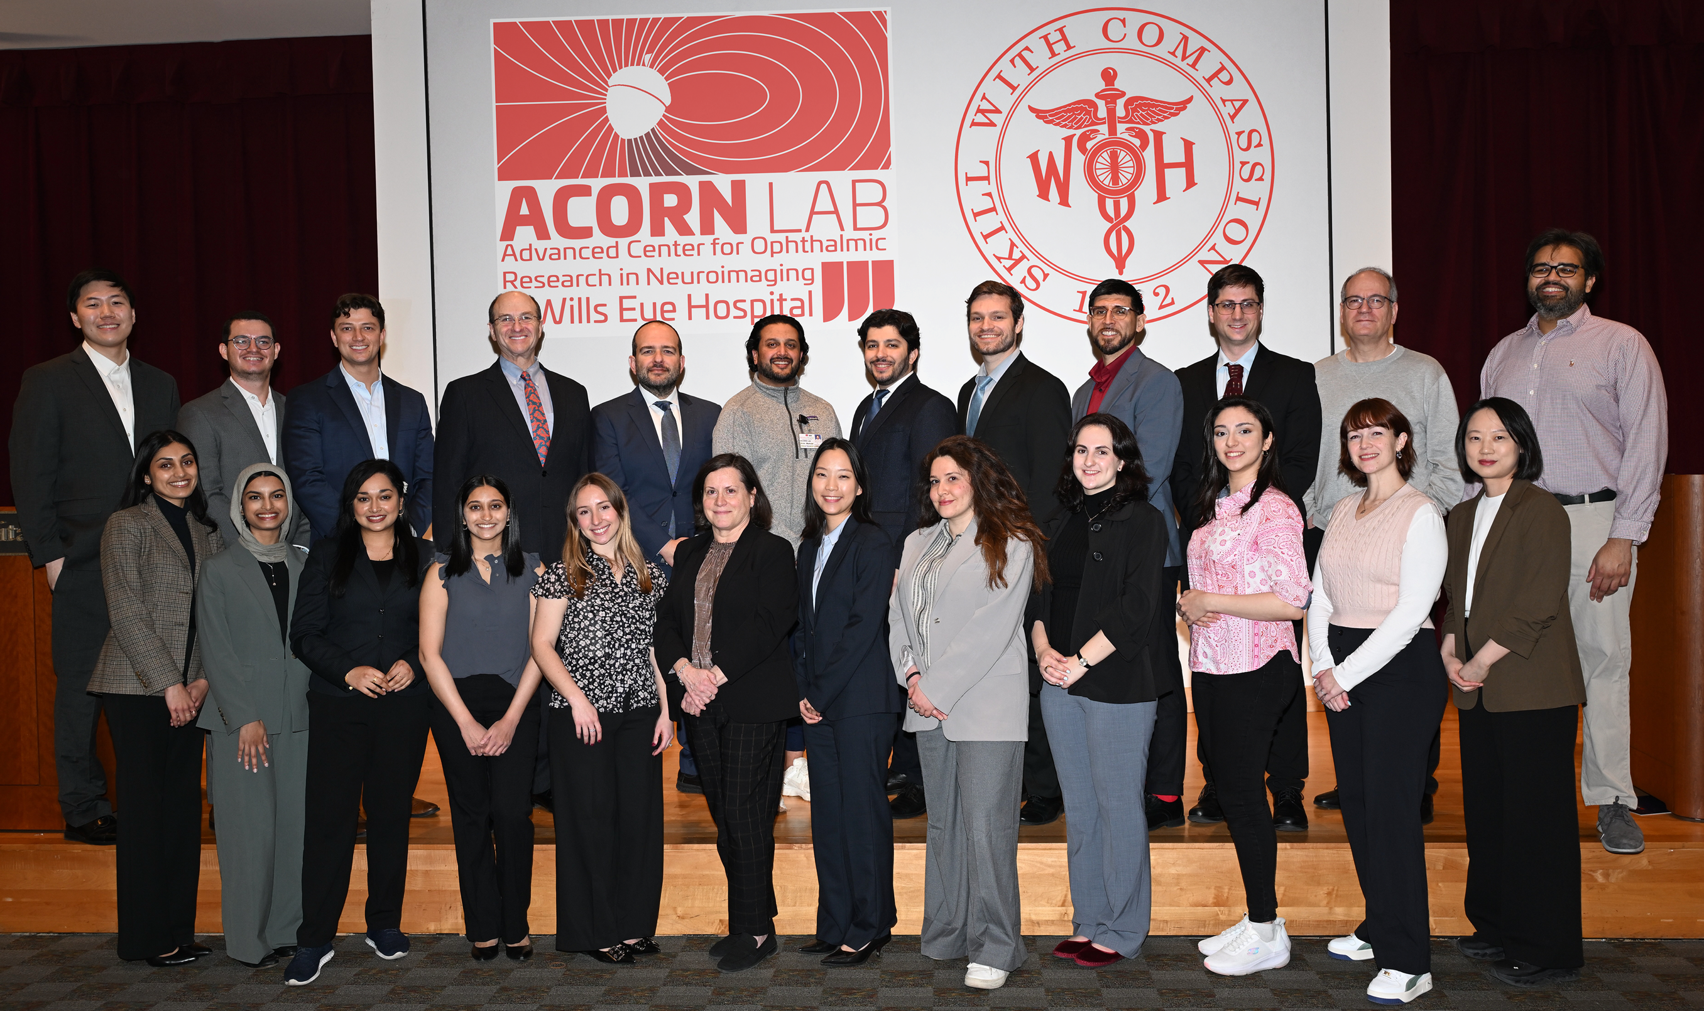
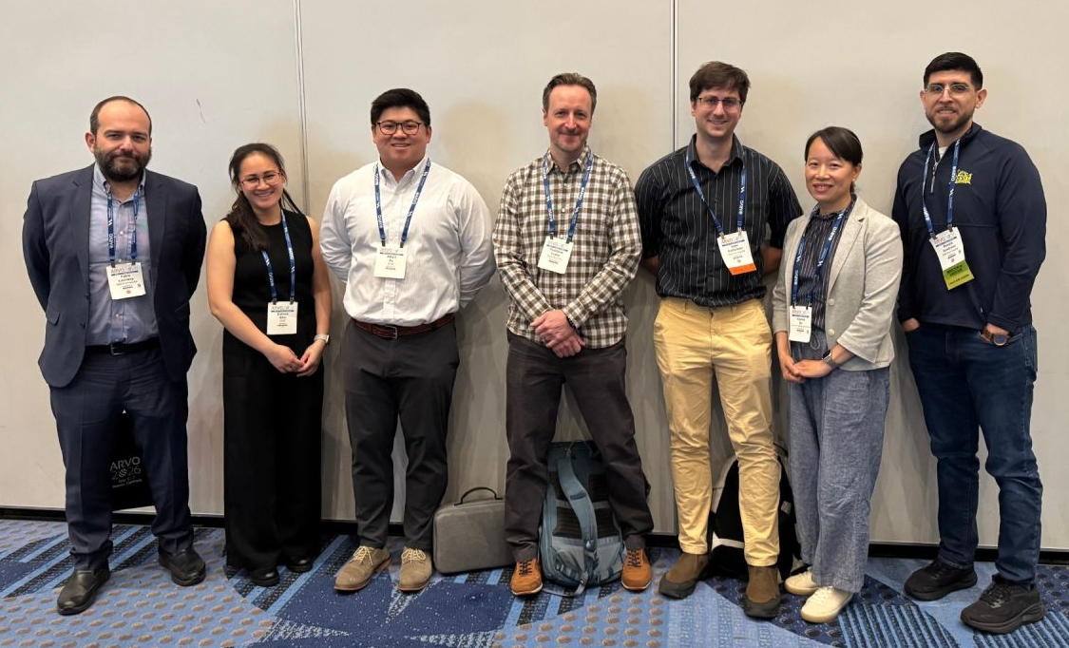


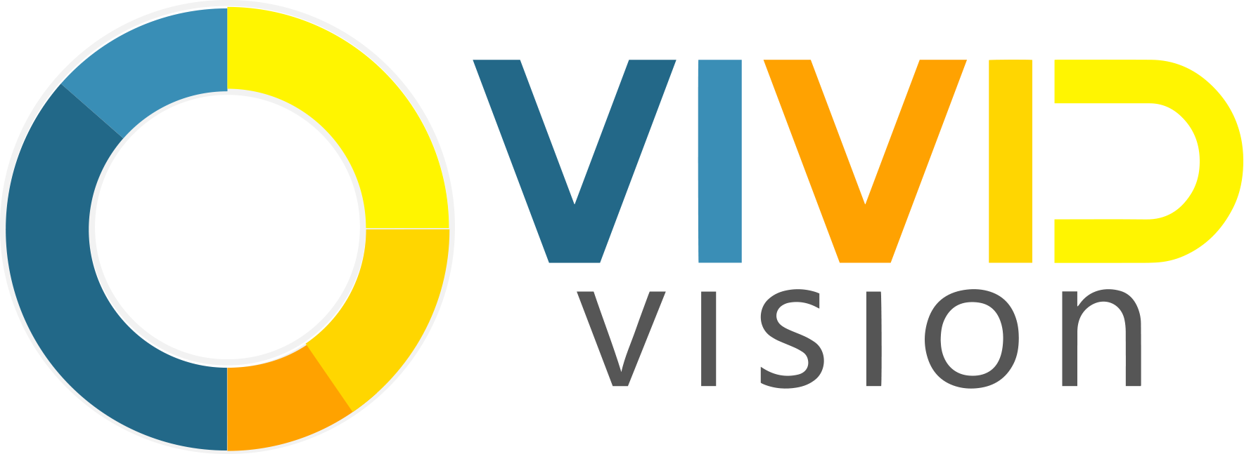


Thank You!
Wills Eye: Yoav Gutterman; Vivin Mathew; Heather Giusto; Ahna Donahue; Batsheva Rubin;
Bo Young Kim; Gadi Wollstein; Fabio Lavinsky; Joel S. Schuman
Vivid Vision: Benjamin T. Backus; Thaddeus B. Czuba; James Blaha; Ranran L. French
UCSF: Corinne Shiu; Michael S. Deiner; Yvonne Ou
Drexel: Special thanks to Dr. Hasan Ayaz and Dr. Adrian Curtin for the advice and guidance!
- R44-EY035203
- R01-EY013178
For more information:
rzambrano@willseye.org
willseye.org/acorn-lab

